Slide 1
Summary of the experiments

Slide 2
Content
Experimental results of different feature set combination using XGBoost algorithm
5 features
6 features
7 features
8 features
9 features
10 features

Slide 3
Accuracy vs Number of Features

Slide 4

5 Features Combination
A total of 792 [$c(12,5)]$ models are generated, trained and tested
Top 10 models based on the accuracy metric is presented in the table below
 | Features | Accuracy
1 | FPG, HbA1c, Physical Activity, Family History, Sex | 0.753
2 | FPG, HbA1c, Smoking, Physical Activity, Sex | 0.746
3 | FPG, HbA1c, Drinking, Family History, Sex | 0.746
4 | FPG, HbA1c, Triglyceride, Physical Activity, Sex | 0.745
5 | FPG, HbA1c, Uric Acid, Physical Activity, Sex | 0.745
6 | FPG, HbA1c, Uric Acid, Smoking, Age | 0.745
7 | FPG, HbA1c, Drinking, Physical Activity, Family History | 0.743
8 | FPG, HbA1c, Family History, Sex, Age | 0.743
9 | FPG, HbA1c, Uric Acid, Sex, Age | 0.743
10 | FPG, HbA1c, Triglyceride, Uric Acid, Age | 0.741

Slide 5

6 Features Combination
A total of 924 [$c(12,6)]$ models are generated, trained and tested
Top 10 models based on the accuracy metric is presented in the table below
 | Features | Accuracy
1 | FPG, HbA1c, Uric acid, Smoking, Physical Activity, Sex | 0.753
2 | FPG, HbA1c, Uric acid, Drinking, Physical Activity, Sex | 0.751
3 | FPG, HbA1c, Smoking, Family History, Sex, Age | 0.751
4 | FPG, HbA1c, BMI, Smoking, Physical Activity, Sex | 0.750
5 | FPG, HbA1c, Triglyceride, Uric acid, Physical Activity, Sex | 0.750
6 | FPG, HbA1c, Smoking, Physical Activity, Family History, Sex | 0.750
7 | FPG, HbA1c, BMI, Family History, Sex, Age | 0.748
8 | FPG, HbA1c, Uric acid, Drinking, Family History, Sex | 0.748
9 | FPG, HbA1c, smoking, Physical activity, Sex, Age | 0.748
10 | FPG, HbA1c, Triglyceride, smoking, Physical activity, Sex | 0.748

Slide 6
7 Features Combination
A total of 792 [$c(12,5)]$ models are generated, trained and tested
Top 10 models based on the accuracy metric is presented in the table below
 | Features | Accuracy
1 | FPG, HbA1c, BMI, Uric acid, Smoking, Sex, Age | 0.750
2 | FPG, HbA1c, BMI, GTP gamma, Uric acid, Sex, Age | 0.750
3 | FPG, HbA1c, Triglyceride, BMI, GTP gamma, Sex, Age | 0.750
4 | FPG, HbA1c, Triglyceride, BMI, Uric acid, Sex, Age | 0.750
5 | FPG, HbA1c, BMI, Smoking, Physical Activity, Sex, Age | 0.748
6 | FPG, HbA1c, Smoking, Physical Activity, Family History, Sex, Age | 0.748
7 | FPG, HbA1c, Smoking, Drinking, Physical Activity, Family History, Sex | 0.748
8 | FPG, HbA1c, Triglyceride, BMI, Physical Activity, Sex, Age | 0.748
9 | FPG, HbA1c, Triglyceride, Smoking, Physical Activity, Sex, Age | 0.748
10 | FPG, HbA1c, BMI, Physical Activity, Family History, Sex, Age | 0.746

Slide 7

8 Features Combination
A total of 495 [$c(12,8)]$ models are generated, trained and tested
Top 10 models based on the accuracy metric is presented in the table below
 | Features | Accuracy
1 | FPG, HbA1c, Triglyceride, BMI, Uric acid, smoking, Sex, Age | 0.753
2 | FPG, HbA1c, Triglyceride, BMI, GTP gamma, smoking, Sex, Age | 0.750
3 | FPG, HbA1c, Triglyceride, BMI, GTP gamma, Family history, Sex, Age | 0.748
4 | FPG, HbA1c, Triglyceride, BMI, Uric acid, Family history, Sex, Age | 0.748
5 | FPG, HbA1c, BMI, GTP gamma, Uric acid, smoking, Family history, Age | 0.748
6 | FPG, HbA1c, BMI, GTP gamma, smoking, Family history, Sex, Age | 0.748
7 | FPG, HbA1c, BMI, GTP gamma, Physical activity, Family history, Sex, Age | 0.748
8 | FPG, HbA1c, Triglyceride, smoking, Physical activity, Family history, Sex, Age | 0.746
9 | FPG, HbA1c, Triglyceride, BMI, Uric acid, Physical activity, Sex, Age | 0.746
10 | FPG, HbA1c, BMI, GTP gamma, Uric acid, smoking, Sex, Age | 0.746

Slide 8

9 Features Combination
A total of 220 [$c(12,9)]$ models are generated, trained and tested
Top 10 models based on the accuracy metric is presented in the table below
 | Features | Accuracy
1 | FPG, HbA1c, Triglyceride, BMI, Uric acid, smoking, Physical activity, Sex, Age | 0.750
2 | FPG, HbA1c, Triglyceride, BMI, GTP gamma, smoking, Family history, Sex, Age | 0.748
3 | FPG, HbA1c, Triglyceride, BMI, GTP gamma, Uric acid, smoking, Family history, Age | 0.746
4 | FPG, HbA1c, BMI, GTP gamma, smoking, Drinking, Family history, Sex, Age | 0.746
5 | FPG, HbA1c, BMI, GTP gamma, Uric acid, Physical activity, Family history, Sex, Age | 0.745
6 | FPG, HbA1c, BMI, GTP gamma, Uric acid, smoking, Family history, Sex, Age | 0.745
7 | FPG, HbA1c, BMI, GTP gamma, Uric acid, smoking, Physical activity, Sex, Age | 0.745
8 | FPG, HbA1c, BMI, GTP gamma, smoking, Drinking, Physical activity, Sex, Age | 0.745
9 | FPG, HbA1c, BMI, GTP gamma, Uric acid, smoking, Drinking, Physical activity, Age | 0.745
10 | FPG, HbA1c, BMI, Uric acid, smoking, Physical activity, Family history, Sex, Age | 0.745

Slide 9

10 Features Combination
A total of 66 [$c(12,10)]$ models are generated, trained and tested
Top 10 models based on the accuracy metric is presented in the table below
 | Features | Accuracy
1 | FPG, HbA1c, Triglyceride, BMI, GTP gamma, Uric acid, smoking, Family history, Sex, Age | 0.745
2 | FPG, HbA1c, BMI, GTP gamma, smoking, Drinking, Physical activity, Family history, Sex, Age | 0.745
3 | FPG, HbA1c, Triglyceride, BMI, GTP gamma, Uric acid, smoking, Drinking, Sex, Age | 0.743
4 | FPG, HbA1c, Triglyceride, BMI, GTP gamma, Uric acid, smoking, Physical activity, Sex, Age | 0.743
5 | FPG, HbA1c, Triglyceride, BMI, Uric acid, smoking, Physical activity, Family history, Sex, Age | 0.743
6 | FPG, HbA1c, BMI, GTP gamma, Uric acid, smoking, Physical activity, Family history, Sex, Age | 0.741
7 | FPG, HbA1c, BMI, GTP gamma, Uric acid, smoking, Drinking, Family history, Sex, Age | 0.741
8 | FPG, HbA1c, Triglyceride, BMI, GTP gamma, Uric acid, Physical activity, Family history, Sex, Age | 0.741
9 | FPG, HbA1c, Triglyceride, BMI, GTP gamma, Uric acid, smoking, Drinking, Family history, Age | 0.741
10 | FPG, HbA1c, Triglyceride, BMI, GTP gamma, smoking, Drinking, Family history, Sex, Age | 0.740

Slide 10
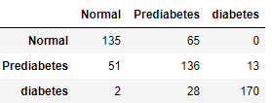
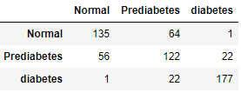
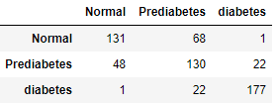
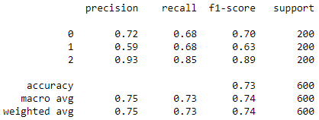
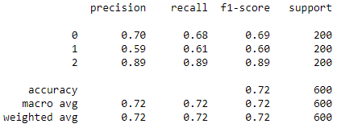
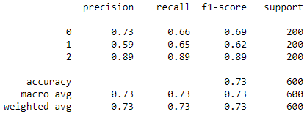
5 Features (Traditional features)
RF
Accuracy = 0.735
XGBoost
Accuracy = 0.723
SVM
Accuracy = 0.73

Slide 11
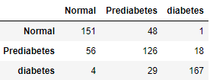
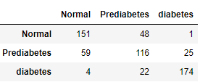
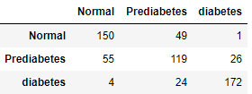
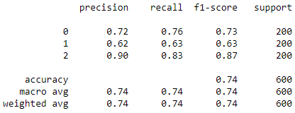
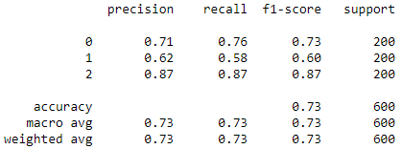
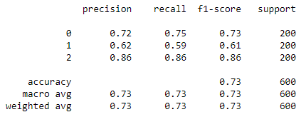
12 Features
RF
Accuracy = 0.74
XGBoost
Accuracy = 0.735
SVM
Accuracy = 0.735

Slide 12
Ensemble Approach
In this sub section, top 5 accurate models from each feature sets are selected and ensembled using
Stacking
Soft voting
Hard voting
The algorithms used in this experiment are
RF
SVM
XGBoost
A total of 15 models are used for each ensemble technique

Slide 13
Ensemble Approach

Slide 14
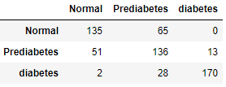
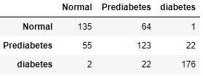
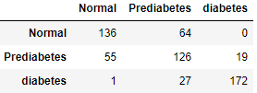
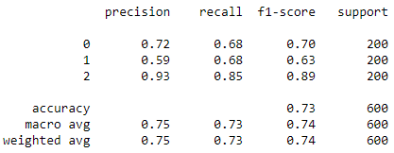
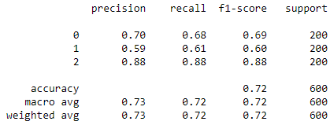
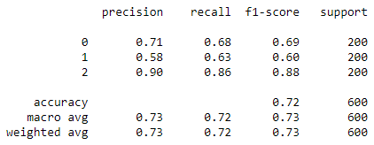
5 Features Combination
 | Features
1 | FPG, HbA1c, Physical Activity, Family History, Sex
2 | FPG, HbA1c, Smoking, Physical Activity, Sex
3 | FPG, HbA1c, Drinking, Family History, Sex
4 | FPG, HbA1c, Triglyceride, Physical Activity, Sex
5 | FPG, HbA1c, Uric Acid, Physical Activity, Sex
Stacking Classifier
accuracy 0.735
Hard Voting Classifier
accuracy 0.723
Soft Voting Classifier
accuracy 0.723

Slide 15
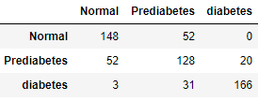
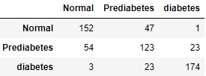
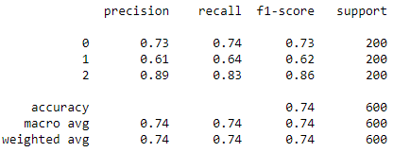
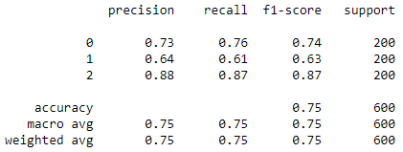
6 Features Combination
 | Features
1 | FPG, HbA1c, Uric acid, Smoking, Physical Activity, Sex
2 | FPG, HbA1c, Uric acid, Drinking, Physical Activity, Sex
3 | FPG, HbA1c, Smoking, Family History, Sex, Age
4 | FPG, HbA1c, BMI, Smoking, Physical Activity, Sex
5 | FPG, HbA1c, Triglyceride, Uric acid, Physical Activity, Sex
Stacking Classifier
accuracy 0.736
Hard Voting Classifier
accuracy 0.748
Soft Voting Classifier
accuracy

Slide 16
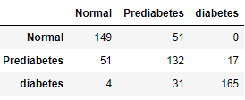
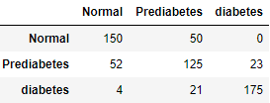
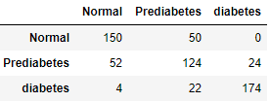
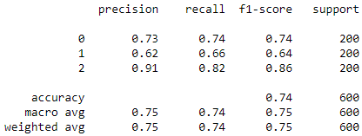
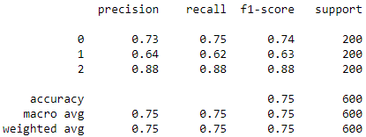
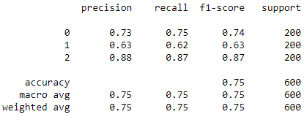
7 Features Combination
 | Features
1 | FPG, HbA1c, Uric acid, Smoking, Physical Activity, Sex
2 | FPG, HbA1c, Uric acid, Drinking, Physical Activity, Sex
3 | FPG, HbA1c, Smoking, Family History, Sex, Age
4 | FPG, HbA1c, BMI, Smoking, Physical Activity, Sex
5 | FPG, HbA1c, Triglyceride, Uric acid, Physical Activity, Sex
Stacking Classifier
accuracy 0.743
Hard Voting Classifier
accuracy 0.75
Soft Voting Classifier
accuracy 0.746

Slide 17
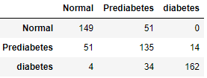
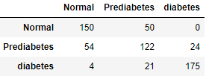
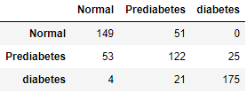
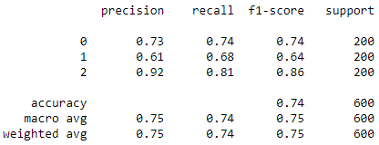
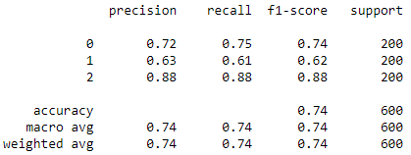
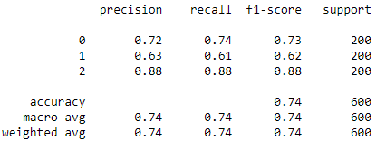
8 Features Combination
 | Features
1 | FPG, HbA1c, Triglyceride, BMI, Uric acid, smoking, Sex, Age
2 | FPG, HbA1c, Triglyceride, BMI, GTP gamma, smoking, Sex, Age
3 | FPG, HbA1c, Triglyceride, BMI, GTP gamma, Family history, Sex, Age
4 | FPG, HbA1c, Triglyceride, BMI, Uric acid, Family history, Sex, Age
5 | FPG, HbA1c, BMI, GTP gamma, Uric acid, smoking, Family history, Age
Stacking Classifier
accuracy 0.743
Hard Voting Classifier
accuracy 0.745
Soft Voting Classifier
accuracy 0.743

Slide 18
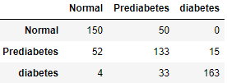
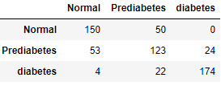
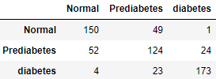
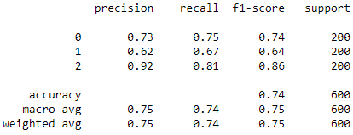
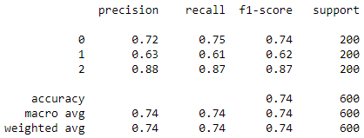
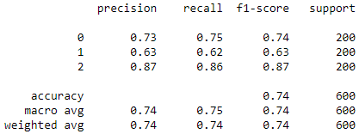
9 Features Combination
 | Features
1 | FPG, HbA1c, Triglyceride, BMI, Uric acid, smoking, Physical activity, Sex, Age
2 | FPG, HbA1c, Triglyceride, BMI, GTP gamma, smoking, Family history, Sex, Age
3 | FPG, HbA1c, Triglyceride, BMI, GTP gamma, Uric acid, smoking, Family history, Age
4 | FPG, HbA1c, BMI, GTP gamma, smoking, Drinking, Family history, Sex, Age
5 | FPG, HbA1c, BMI, GTP gamma, Uric acid, Physical activity, Family history, Sex, Age
Stacking Classifier
accuracy 0.743
Hard Voting Classifier
accuracy 0.745
Soft Voting Classifier
accuracy 0.745

Slide 19
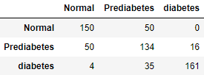
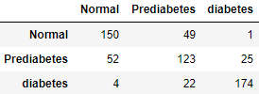
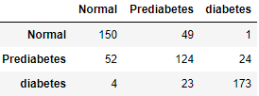
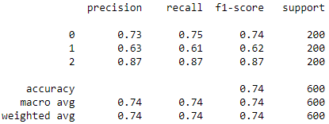
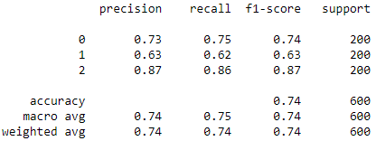

10 Features Combination
 | Features
1 | FPG, HbA1c, Triglyceride, BMI, GTP gamma, Uric acid, smoking, Family history, Sex, Age
2 | FPG, HbA1c, BMI, GTP gamma, smoking, Drinking, Physical activity, Family history, Sex, Age
3 | FPG, HbA1c, Triglyceride, BMI, GTP gamma, Uric acid, smoking, Drinking, Sex, Age
4 | FPG, HbA1c, Triglyceride, BMI, GTP gamma, Uric acid, smoking, Physical activity, Sex, Age
5 | FPG, HbA1c, Triglyceride, BMI, Uric acid, smoking, Physical activity, Family history, Sex, Age
Stacking Classifier
accuracy 0.741
Hard Voting Classifier
accuracy 0.745
Soft Voting Classifier
accuracy 0.745

Slide 20
12 Features

